Slide 1



Optimizers
Deep Learning
Course
18 Slide

Slide 2

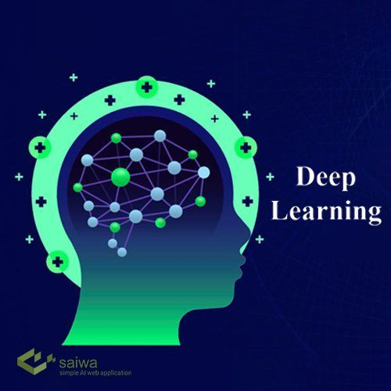

PRESENTATION
Content List
₀₁ Optimizer
₀₂ Gradient Descent
₀₃ Momentum optimizer
04 AdaGrad Optimizer
05 RMSProp Optimizer
06 Adam Optimizer

Slide 3

01
Optimizers
Optimizers: adjust weights of the model based on the gradient of loss function, aiming to minimize the loss and improve model accuracy.
In TensorFlow, optimizers are available through tf.keras.optimizers. You can use these optimizers in your models by specifying them when compiling the model.

Slide 4
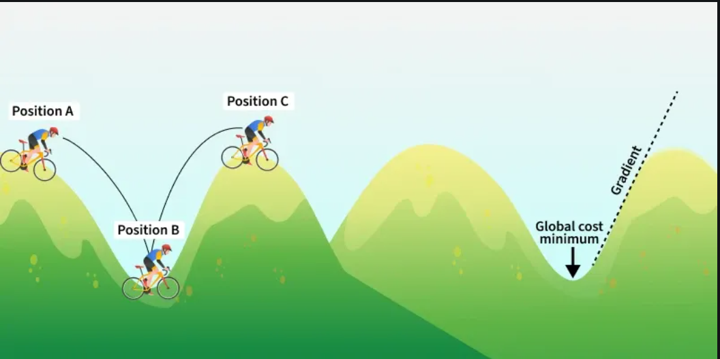
02
Gradient Descent
Gradient Descent: is an iterative optimization algorithm used to minimize a cost function by adjusting model parameters in the direction of the steepest descent of the function’s gradient.
In simple terms, it finds the optimal values of weights and biases by gradually reducing the error between predicted and actual outputs.

Slide 5
02
Gradient Descent
Imagine you're at the top of a hill and your goal is to find the lowest point in the valley. You can't see the entire valley from the top, but you can feel the slope under your feet.
Start at the Top: You begin at the top of the hill (this is like starting with random guesses for the model's parameters).
Feel the Slope: You look around to find out which direction the ground is sloping down. This is like calculating the gradient, which tells you the steepest way downhill.
Take a Step Down: Move in the direction where the slope is steepest (this is adjusting the model's parameters). The bigger the slope, the bigger the step you take.
Repeat: You keep repeating the process — feeling the slope and moving downhill — until you reach the bottom of the valley (this is when the model has learned and minimized the error).
The key idea is that, just like walking down a hill, Gradient Descent moves towards the "bottom" or minimum of the loss function, which represents the error in predictions.

Slide 6
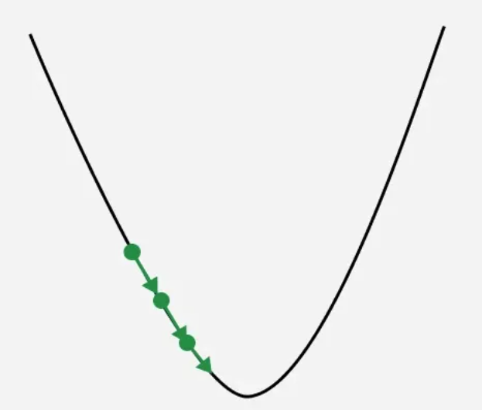
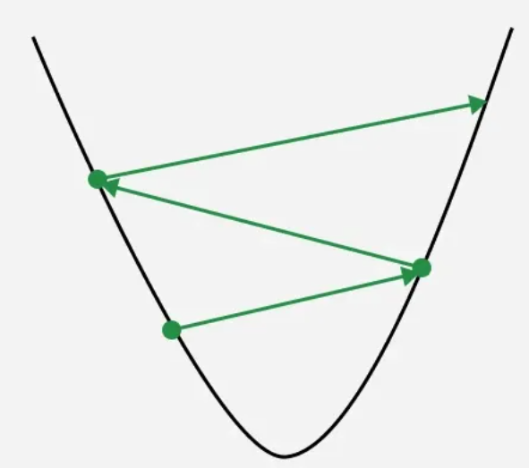
02
Gradient Descent
What is Learning Rate?
Learning rate is a important hyperparameter in gradient descent that controls how big or small the steps should be when going downwards in gradient for updating models parameters. It is essential to determines how quickly or slowly the algorithm converges toward minimum of cost function.
if Learning rate is too small: The algorithm will take tiny steps during iteration and converge very slowly. This can significantly increases training time and computational cost especially for large datasets.
If Learning rate is too big: The algorithm may take huge steps leading overshooting the minimum of cost function without settling. It fail to converge causing the algorithm to oscillate. This process is termed as exploding gradient problem.

Slide 7
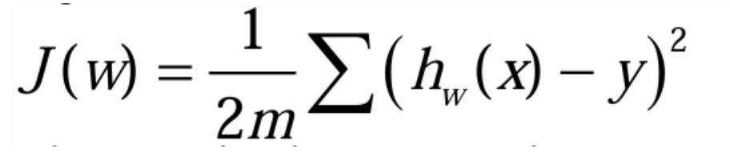
02
Gradient Descent
For simplicity let's consider a linear regression model with a single input feature x and target y The loss function (or cost function) for a single data point is defined as the Mean Squared Error (MSE):
h(x) ​=x⋅w+b: The predicted value.
To optimize the model parameters w, we compute the gradient of the loss function with respect to wThis process involves taking the partial derivatives of J(w)

Slide 8
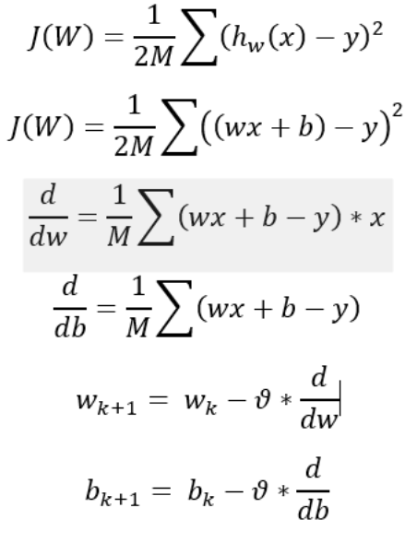
02
Gradient Descent

Slide 9
02
Gradient Descent
Batch Gradient Descent: Batch Gradient Descent computes gradients using the entire dataset in each iteration.
Stochastic Gradient Descent (SGD): SGD uses one data point per iteration to compute gradients, making it faster.
Mini-batch Gradient Descent: Mini-batch Gradient Descent combines batch and SGD by using small batches of data for updates.

Slide 10

03
Momentum optimizer
Momentum : is a concept from physics where an object’s motion depends not only on the current force but also on its previous velocity. In the context of gradient optimization it refers to a method that smoothens the optimization trajectory by adding a term that helps the optimizer remember the past gradients.
Remember Gradient Descent: W(k+1) = Wk + ΔWk
ΔWk = - LR * d/dw here the gradient term
Here in momentum depend also on previous gradien ΔWk = -LR * (d/dw) + αΔW(k-1)
if alpha = 0 mean I return to normal Gradient Descent.
يعنى زي مبقول ان ال weight الحالي ليه علاقه بال weight السابق بقول ان معدل التغير الحالي ليه علاقه بمعدل التغير السابق

Slide 11
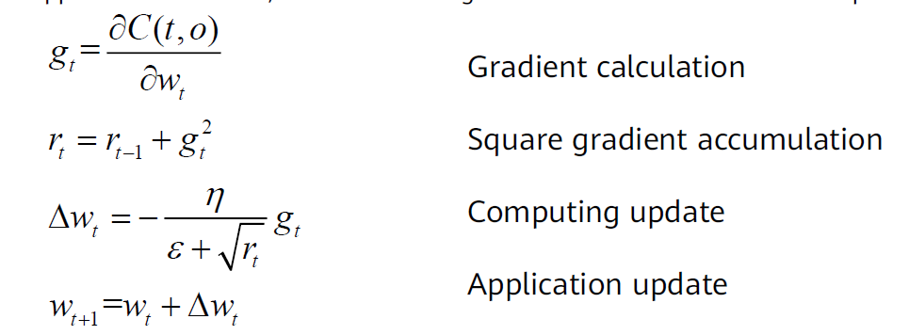
04
AdaGrad Optimizer
AdaGrad(Adaptive Gradient Algorithm) : is an optimization method that adjusts the learning rate for each parameter during training. Unlike standard gradient descent with a fixed rate, Adagrad uses past gradients to scale updates making it effective for sparse data and varying feature magnitudes.
- The primary concept behind Adagrad is the idea of adapting the learning rate based on the historical sum of squared gradients for each parameter. Here's a step-by-step explanation of how Adagrad works:
Initialization: Adagrad begins by initializing the parameter values randomly, just like other optimization algorithms. Additionally, it initializes a running sum of squared gradients for each parameter which will track the gradients over time.

Slide 12
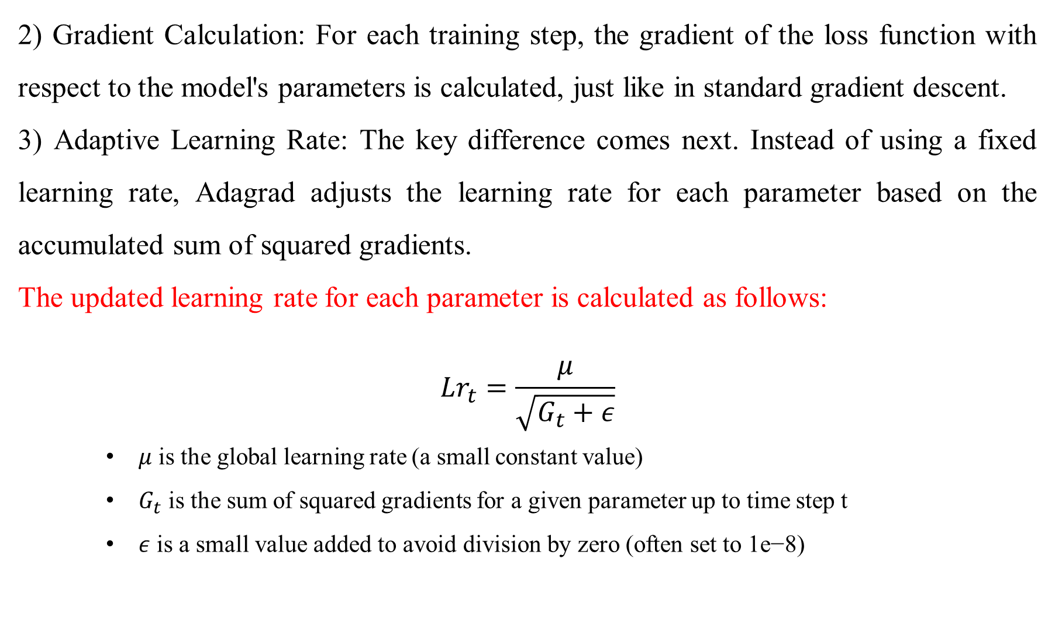
04
AdaGrad Optimizer
2) Gradient Calculation: For each training step, the gradient of the loss function with respect to the model's parameters is calculated, just like in standard gradient descent.
3) Adaptive Learning Rate: The key difference comes next. Instead of using a fixed learning rate, Adagrad adjusts the learning rate for each parameter based on the accumulated sum of squared gradients.
The updated learning rate for each parameter is calculated as follows:
$${Lr}_{t}=\frac{μ}{\sqrt{G_{t}+ε}}$$
$μ$ is the global learning rate (a small constant value)
$G_{t}$ is the sum of squared gradients for a given parameter up to time step t
$ε$ is a small value added to avoid division by zero (often set to 1e−8)

Slide 13
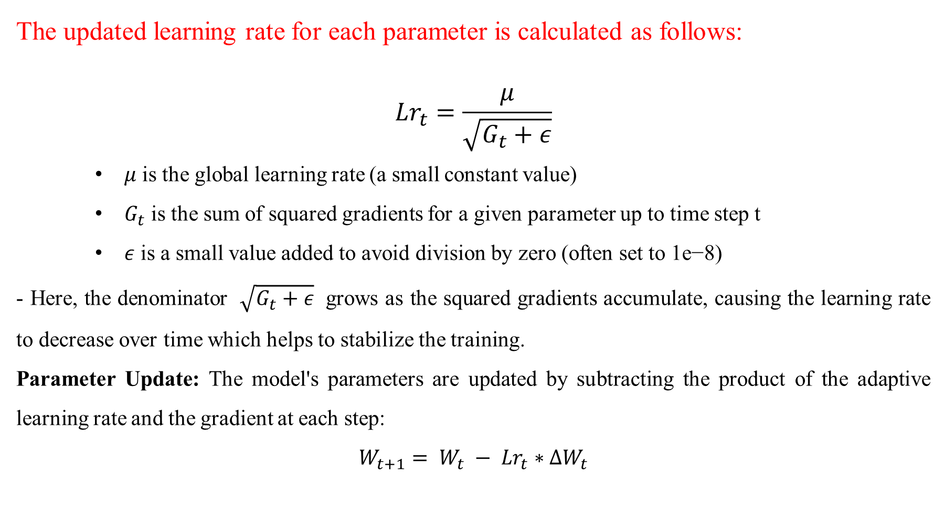
04
AdaGrad Optimizer
The updated learning rate for each parameter is calculated as follows:
$${Lr}_{t}=\frac{μ}{\sqrt{G_{t}+ε}}$$
$μ$ is the global learning rate (a small constant value)
$G_{t}$ is the sum of squared gradients for a given parameter up to time step t
$ε$ is a small value added to avoid division by zero (often set to 1e−8)
- Here, the denominator $\sqrt{G_{t}+ε}$​​ grows as the squared gradients accumulate, causing the learning rate to decrease over time which helps to stabilize the training.
Parameter Update: The model's parameters are updated by subtracting the product of the adaptive learning rate and the gradient at each step:
$$W_{t+1}= W_{t} − {Lr}_{t}∗ΔW_{t}$$

Slide 14
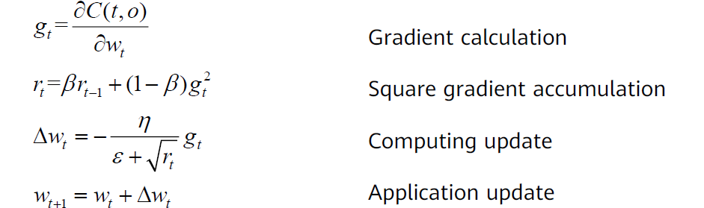
05
RMSProp Optimizer
RMSProp (Root Mean Square Propagation) is an adaptive learning rate optimization algorithm designed to improve the performance and speed of training deep learning models.
RMSProp was developed to address the limitations of previous optimization methods such as SGD (Stochastic Gradient Descent) and AdaGrad as SGD uses a constant learning rate which can be inefficient and AdaGrad reduces the learning rate too aggressively.
RMSProp balances by adapting the learning rates based on a moving average of squared gradients. This approach helps in maintaining a balance between efficient convergence and stability during the training process making RMSProp a widely used optimization algorithm in modern deep learning.
وجدوا علاقه عكسيه بتربط مربع ال gradient بال gradient اللى قبلو

Slide 15
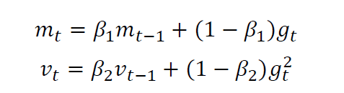
06
Adam Optimizer
Adam (Adaptive Moment Estimation) optimizer combines the advantages of Momentum and RMSprop techniques to adjust learning rates during training. It works well with large datasets and complex models because it uses memory efficiently and adapts the learning rate for each parameter automatically.
Adam maintains two additional variables 𝑚𝑡 and 𝑣𝑡 for each variable to be trained:
وجدوا علاقه عكسيه بتربط مربع ال gradient بال gradient اللى قبله طب ليه معملش ده مع ال gradient نفسوا؟؟

Slide 16
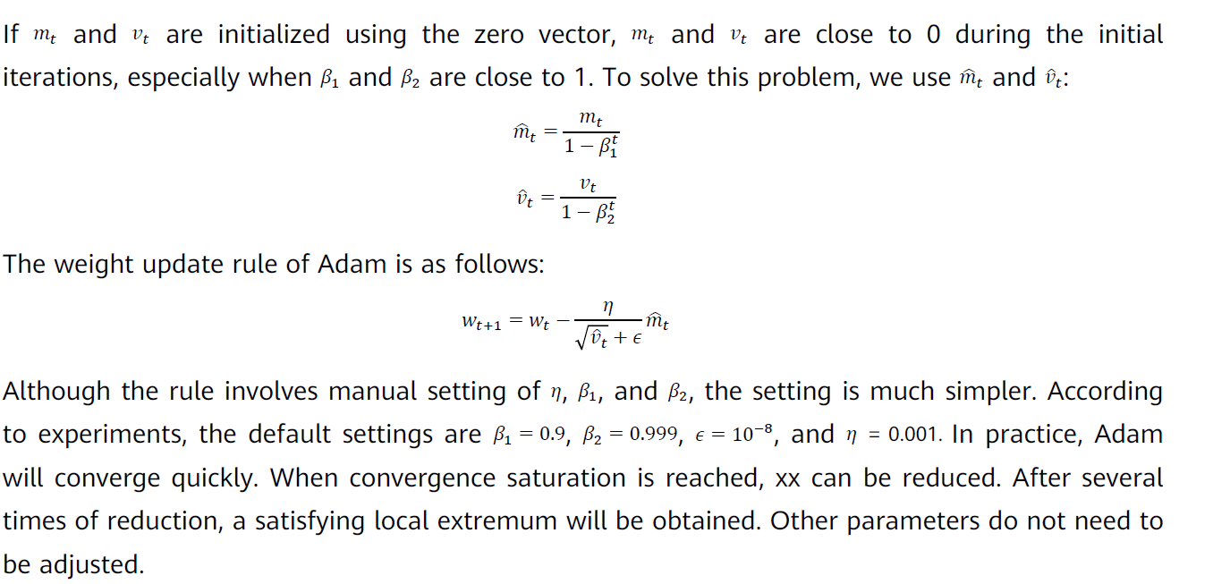
06
Adam Optimizer
وجدوا علاقه عكسيه بتربط مربع ال gradient بال gradient اللى قبله طب ليه معملش ده مع ال gradient نفسوا؟؟

Slide 17

Any Question??

Slide 18
Thank You…!
End

